Slide 1

OPERATING SYSTEMS
Disk Scheduling
Class Presentations on Operating System
by Subhash Chand Agrawal

Slide 2
Disk Scheduling
As we know, a process needs two type of time, CPU time and IO time. For I/O, it requests the Operating system to access the disk.
However, the operating system must be fare enough to satisfy each request and at the same time, operating system must maintain the efficiency and speed of process execution.
The technique that operating system uses to determine the request which is to be satisfied next is called disk scheduling.

Slide 3


Moving-head Disk Mechanism

Slide 4
Seek Time
Seek time is the time taken in locating the disk arm to a specified track where the read/write request will be satisfied.
Rotational Latency
It is the time taken by the desired sector to rotate itself to the position from where it can access the R/W heads.
Transfer Time
It is the time taken to transfer the data.

Slide 5
Disk Access Time
Disk access time is given as,
Disk Access Time = Rotational Latency + Seek Time + Transfer Time
Disk Response Time
It is the average of time spent by each request waiting for the IO operation.

Slide 6
Purpose of Disk Scheduling
The main purpose of disk scheduling algorithm is to select a disk request from the queue of IO requests and decide the schedule when this request will be processed.

Slide 7
Goal of Disk Scheduling Algorithm
Fairness
High throughout
Minimal traveling head time

Slide 8
Disk Scheduling Algorithms
FCFS scheduling algorithm
SSTF (shortest seek time first) algorithm
SCAN scheduling
C-SCAN scheduling
LOOK Scheduling
C-LOOK scheduling

Slide 9
Disk Scheduling Algorithms
We illustrate them with a I/O request queue (cylinders are between 0-199):
queue = 98, 183, 37, 122, 14, 124, 65, 67
head starts at 53

Slide 10

First Come First Serve (FCFS) Example
Illustration shows total head movement of 640 cylinders.

Slide 11
First Come First Serve (FCFS)
Handle I/O requests sequentially.
Fair to all processes.
Approaches random scheduling in performance if there are many processes/requests.
Suffers from global zigzag effect.

Slide 12

Shortest Seek Time First (SSTF) Example
Illustration shows total head movement of 236 cylinders.

Slide 13
Shortest Seek Time First (SSTF)
Selects the request with the minimum seek time from the current head position.
Also called Shortest Seek Distance First (SSDF) – It’s easier to compute distances.
It’s biased in favor of the middle cylinders requests.
SSTF scheduling is a form of SJF scheduling; may cause starvation of some requests.

Slide 14
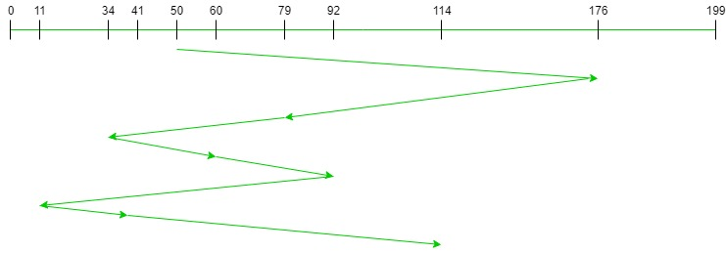
FCFS
Request sequence = {176, 79, 34, 60, 92, 11, 41, 114}
Initial head position = 50
Total number of seek operations or head movement?
Therefore, the total seek count is calculated as:
=(176-50)+(176-79)+(79-34)+(60-34)+(92-60)+(92-11)+(41-11)+(114-41) = 510

Slide 15
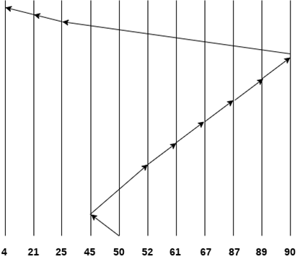
SSTF
Consider the following disk request sequence for a disk with 100 tracks
45, 21, 67, 90, 4, 89, 52, 61, 87, 25
Head pointer starting at 50. Find the number of head movements in cylinders using SSTF scheduling.
Number of cylinders = 5 + 7 + 9 + 6 + 20 + 2 + 1 + 65 + 4 + 17 = 136

Slide 16
Elevator Algorithms
Algorithms based on the common elevator principle.
Four combinations of Elevator algorithms:
– Service in both directions or in only one direction.
– Go until last cylinder or until last I/O request.
Go until
Go until the
last request
Direction
Go until the
last cylinder
Service both
directions
Scan
Look
Service in only
one direction
C-Scan
C-Look

Slide 17
Scan
The disk arm starts at one end of the disk, and moves toward the other end, servicing requests until it gets to the other end of the disk, where the head movement is reversed and servicing continues.
It moves in both directions until both ends.
Tends to stay more at the ends so more fair to the extreme cylinder requests.

Slide 18

Scan Example
Assuming disk arm is moving toward 0
Illustration shows total head movement of 208 cylinders.

Slide 19
C-Scan
The head moves from one end of the disk to the other, servicing requests as it goes. When it reaches the other end, however, it immediately returns to the beginning of the disk, without servicing any requests on the return trip.
Treats the cylinders as a circular list that wraps around from the last cylinder to the first one.
Provides a more uniform wait time than SCAN; it treats all cylinders in the same manner.

Slide 20

C-Scan Example

Slide 21
Look
The disk arm starts at the first I/O request on the disk, and moves toward the last I/O request on the other end, servicing requests until it gets to the other extreme I/O request on the disk, where the head movement is reversed and servicing continues.
It moves in both directions until both last I/O requests;

Slide 22
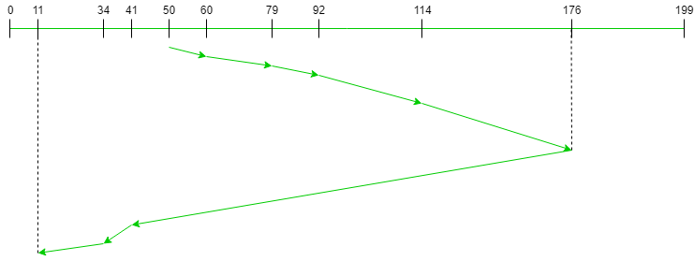
Example
291
Request sequence = {176, 79, 34, 60, 92, 11, 41, 114} Initial head position = 50 Direction = right (We are moving from left to right)

Slide 23
C-Look
Look version of C-Scan.
Arm only goes as far as the last request in each direction, then reverses direction immediately, without first going all the way to the end of the disk.
In general, Circular versions are more fair but pay with a larger total seek time.
Scan versions have a larger total seek time than the corresponding Look versions.

Slide 24
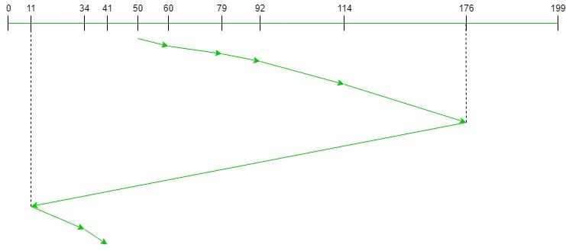
Request sequence = {176, 79, 34, 60, 92, 11, 41, 114}
Initial head position = 50
Direction = right (Moving from left to right)
321

Slide 25

C-Look Example

Slide 26
Q1
Consider a disk system with 100 cylinders. The requests to access the cylinders occur in following sequence-
4, 34, 10, 7, 19, 73, 2, 15, 6, 20
Assuming that the head is currently at cylinder 50, what is the time taken to satisfy all requests if it takes 1 ms to move from one cylinder to adjacent one and shortest seek time first policy is used?
95 ms
119 ms
233 ms
276 ms

Slide 27
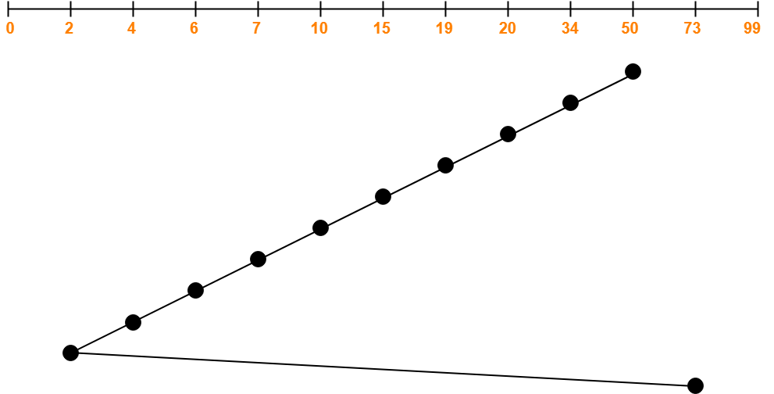
Solution
119

Slide 28
Q2
Consider a disk queue with requests for I/O to blocks on cylinders 98, 183, 41, 122, 14, 124, 65, 67. The SCAN scheduling algorithm is used. The head is initially at cylinder number 53 moving towards larger cylinder numbers on its servicing pass. The cylinders are numbered from 0 to 199. The total head movement (in number of cylinders) incurred while servicing these requests is _______.

Slide 29
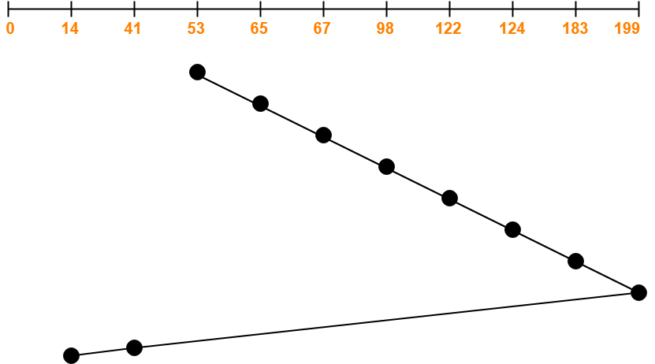
Solution
331

Slide 30
Q3
Consider a disk queue with requests for I/O to blocks on cylinders 98, 183, 41, 122, 14, 124, 65, 67. The C-SCAN scheduling algorithm is used. The head is initially at cylinder number 53 moving towards larger cylinder numbers on its servicing pass. The cylinders are numbered from 0 to 199. The total head movement (in number of cylinders) incurred while servicing these requests is _______.

Slide 31
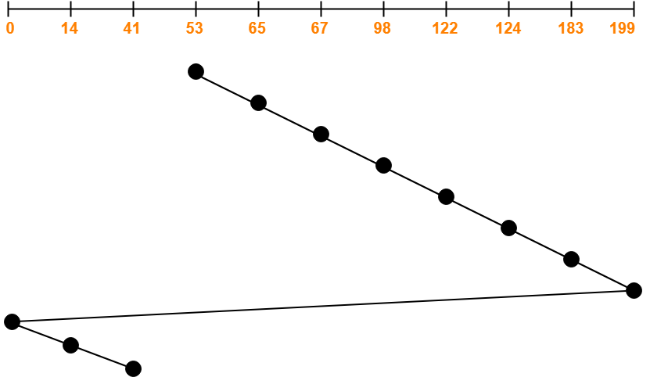
Solution
386

Slide 32
Q4
Consider a disk queue with requests for I/O to blocks on cylinders 98, 183, 41, 122, 14, 124, 65, 67. The LOOK scheduling algorithm is used. The head is initially at cylinder number 53 moving towards larger cylinder numbers on its servicing pass. The cylinders are numbered from 0 to 199. The total head movement (in number of cylinders) incurred while servicing these requests is _______.

Slide 33
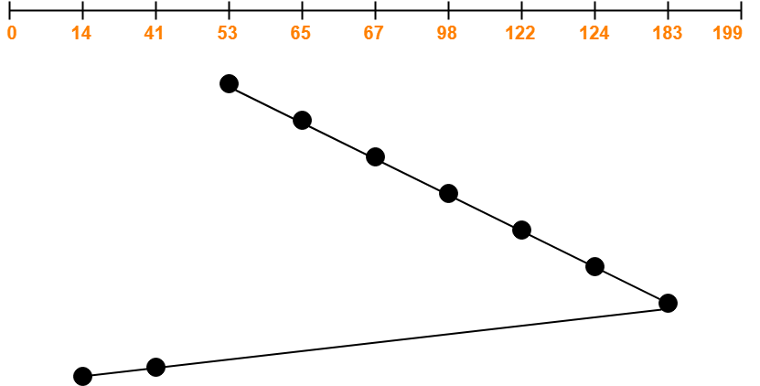
Solution: 299

Slide 34
Q5
Consider a disk queue with requests for I/O to blocks on cylinders 98, 183, 41, 122, 14, 124, 65, 67. The C-LOOK scheduling algorithm is used. The head is initially at cylinder number 53 moving towards larger cylinder numbers on its servicing pass. The cylinders are numbered from 0 to 199. The total head movement (in number of cylinders) incurred while servicing these requests is _______.

Slide 35
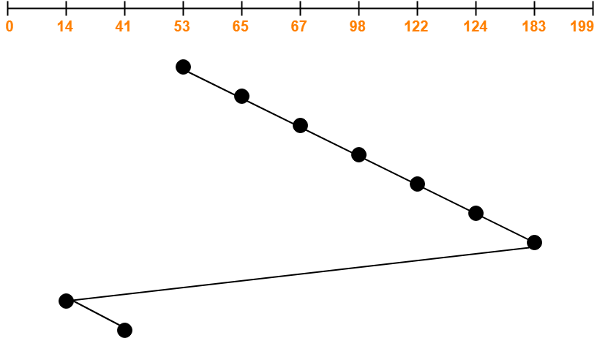
Solution:326

Slide 36
Q6:
Consider a disk queue with requests for I/O to blocks on cylinders 47, 38, 121, 191, 87, 11, 92, 10. The C-LOOK scheduling algorithm is used. The head is initially at cylinder number 63 moving towards larger cylinder numbers on its servicing pass. The cylinders are numbered from 0 to 199. The total head movement (in number of cylinders) incurred while servicing these requests is _______.

Slide 37
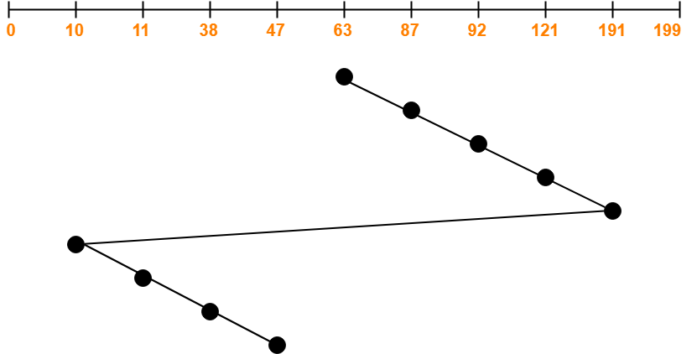
Solution:346

Slide 38
https://www.geeksforgeeks.org/disk-scheduling-algorithms/

